Slide 1
MASK DETECTION USING MACHINE LEARNING
Project Review 3
Team Members:
Siddharth Dahiya 18BCE0446
Ashish Poudel 18BCE2446
Submitted To:
Swathi J.N.

Slide 2
Abstract
Effect of Corona Virus on various sectors like: Health, Education, Finance, etc..
Guidelines made by WHO and Government for preventing rapid spread of Corona virus.
Major guideline include “USE OF MASK”
Video Surveillance for detecting masks in public places is an utmost necessity
We’ll build a Machine Learning model that can be used for video surveillances
Mobile Net v2, CNN algorithms to be used

Slide 3
Introduction
Although it has been more than a year since the outbreak, still coronavirus cases are increasing.
Curve of Corona virus cases
Second wave of Corona Virus pandemic
Various mutants of coronavirus are out there infecting more people per day.
Although the vaccination process has started, it might take months for everyone to get vaccinated.
Although the guideless of wearing masks have been made by WHO and government, many people do not wear masks and it is becoming a sole cause for rapid spread of coronavirus pandemic.
Wearing a mask is a must and it should be monitored carefully for preventing the disease.
So, a mask detection/ mask surveillance system is a need in this situation. So, our project will work primarily on video surveillance to detect masked and unmasked faces.

Slide 4
Literature Survey
S.no | Title | Authors | Year of Publication | Dataset | Methodology considered | Any Pros/Cons Mentioned | Future Work
1 | Study of Masked Face Detection Approach in Video Analytics | Gayatri Deore, Ramakrishna Bodhula, Dr. Vishwas Udpikar, Prof. Vidya | 2016 | Not mentioned | Analog devices Inc.’s Cross core embedded studio and HOGSVM was used for detecting person and distance from camera. Face detection and face parts like eyes, nose and mouth is implemented by Viola Jones’s algorithm. Viola Jones face detection procedure classifies images based on the value of simple features. There are three features, namely two rectangle, three rectangle and four rectangle. The value of a two-rectangle feature is computed by calculating the difference between the sum of the pixels within two rectangular regions. | Pros: Viola-Jones algorithm is robust with very high true detection rate and very low false positive rate, it is real time and at least 2 frames must be processed per second. Cons: Eye detection is reliable but prone to false eye detection | This proposed work may not have been able to detect the person when they are wearing a mask so to improve this accuracy of eye detection can be increased to help recognizing the person through his eye and eye line.

Slide 5
Literature Survey (Continued.…)
S.no | Title | Authors | Year of Publication | Dataset | Methodology considered | Any Pros/Cons Mentioned | Future Work
2 | Deep Learning Based Assistive System to Classify COVID-19 Face Mask for Human Safety with YOLOv3 | Md. Rafiuzzaman Bhuiyan, Sharun Akter Khushbu, Md. Sanzidul Islam | 2020 | Picasso, People Art, KITTI MOD | To configure YOLOv3 object names created to contain the name of the classes which model needs to detect, an input image is passed through the YOLOv3 model, the object detector finds the coordinates that are present in an image. For producing model output the neighbouring cells with high confidence rate of the features were added in the model output. 80 % of the data was used for training and rest is for validation. | Pros: Great detection speed and accuracy Cons: needs large number of backend network parameters and requires high hardware performance | Fast RCNN object detection architecture can be used with YOLOv3 or the new version of YOLOv4 to increase the performance of the face detection system in real time video surveillance

Slide 6
Literature Survey (Continued.…)
S.no | Title | Authors | Year of Publication | Dataset | Methodology considered | Any Pros/Cons Mentioned | Future Work
3 | Face mask detection using MobileNet and Global Pooling Block | Isunuri B Venkateswarlu, Jagadeesh Kakarla, Shree Prakash | 2021 | Simulated masked face dataset | Transfer learning has been used by using a pre-trained model MobileNet to use existing solutions to solve new problems. Global Pooling block transforms a multi-dimensional map into a 1D vector having 64 characteristics. Finally a softmax layer with 2 neurons takes the 1D vector and perform binary classification | Pros: Global pooling block has no parameter to optimize and hence overfitting is avoided in this layer | Face mask detection over multi-face images

Slide 7
Literature Survey (Continued.…)
S.no | Title | Authors | Year of Publication | Dataset | Methodology considered | Any Pros/Cons Mentioned | Future Work
4 | Color quotient based mask detection | Ioan Buciu | 2021 | Masked Face Detection Dataset (MFDD), Realworld Masked Face Recognition Dataset (RMFRD) and Simulated Masked Face Recognition Dataset (SMFRD). | To detect faces a deep neural network (DNNN) learning network based on a single shot detection algorithm is used. Once the face is detected, the face region rectangle is split in 2 parts upper & lower. Now color quotient features are generated in a 2D vector by finding the lower part ratio and upper part ratio. To make the test statistically significant, they have used cross validation partition of the data. This was performed by repeating the creation of the training and test set for 100 times. | Pros: High detection accuracy, works for various resolution and also for different facial poses | To create a market ready product by merging alarm clock and notification system

Slide 8
Literature Survey (Continued.…)
S.no | Title | Authors | Year of Publication | Dataset | Methodology considered | Any Pros/Cons Mentioned | Future Work
5 | Covid-19 Face Mask Detection Using TensorFlow, Keras and OpenCV | Arjya Das, Mohammad Wasif Ansari, Rohini Basak | 2021 | Dataset 1: has 1376 images in which 690 images with people wearing face masks and the rest 686 images with people who do not wear face mask, Dataset 2 from Kaggle consists of 853 images and its countenances are clarified either with a mask or without a mask | The proposed method consists Of a cascade classifier and a pre-trained CNN. For image in the dataset Visualize the image in two categories: mask and no mask. Convert the RGB image to Grey-scale image and resize this image into 100 X 100. Normalize the image and convert it into 4D array. To build the CNN model a convolution layer of 200 filters have been added and a second layer of 200 filters. A flatten layer to the network classifier has been added. In the end a final dense layer with 2 outputs for 2 categories has been inserted and the model is trained. | Pros: The system can efficiently detect partially occluded faces whether they are with masks or hair or hands. Cons: Indistinct moving faces in the video stream are difficult to detect. | It can be extended to check whether a person is wearing a mask properly or not as the nose and mouth should be properly covered.

Slide 9
Literature Survey (Continued.…)
S.no | Title | Authors | Year of Publication | Dataset | Methodology considered | Any Pros/Cons Mentioned | Future Work
6 | The Face Mask Detection For Preventing the Spread of COVID-19 at Politeknik Negeri Batam | Susanto Susanto; Febri Alwan Putra; Riska Analia; Ika Karlina Laila Nur Suciningtyas | 2020 | Not mentioned | Yolo V4 is implemented using two stage detectors. The first-stage detector consists of: Input- Resolution of input image is 1920*1080. Backbone- Darknet53 chosen as detector method, contains 29 Convolutional layers by 3*3 and each layer sent to the neck detector. Neck- PANet applied as the neck detector method. Dense prediction- YOLO v3 model used in this stage to generate the prediction. Second-stage detector: It has a sparse prediction which applies the faster R-CNN. Input to this layer is 3*3 layers got from the neck and the input prediction from the dense prediction. | Pros: The algorithm is able to detect and distinguish a non-wearing and a wearing-mask precisely with any condition of the surrounding environment. | Adding Thermal Detection feature.

Slide 10
Literature Survey (Continued.…)
S.no | Title | Authors | Year of Publication | Dataset | Methodology considered | Any Pros/Cons Mentioned | Future Work
7 | Face Mask Detection Using MobileNetV2 in The Era of COVID-19 Pandemic | Samuel Ady Sanjaya; Suryo Adi Rakhmawan | 2020 | 1. Kaggle dataset and the Real-World Masked Face dataset (RMFD) 2. Dataset taken from CCTV, shop, and traffic lamp camera. (25 Cities of Indonesia) | Collect Data(Masked and Unmasked Data), Preprocessing (Resizing, converting to array, preprocessing using mobilenet v2, etc.), Split Data(75/25), Build Model, Testing and Implementation. MobileNet V2, a convolutional neural network architecture is used. | Pros: The model has 96.85 accuracy. The data collected from different cities can be used for statistical analysis of people wearing masks and appropriate action could be taken for preventing the spread of Covid. | Adding features like detecting social distancing violations in the same model.

Slide 11
Literature Survey (Continued.…)
S.no | Title | Authors | Year of Publication | Dataset | Methodology considered | Any Pros/Cons Mentioned | Future Work
8 | Real-time Face Mask and Social Distancing Violation Detection System using YOLO | Krisha Bhambani; Tanmay Jain; Dr. Kavita A. Sultanpure | 2020 | WIDER-FACE(a face detection benchmark) and MAFA(Masked Faces) Datasets | Yolo v4 is implemented in the paper. The model has backbone, neck and dense/sparse prediction. CSPDarknet53 is used in the backbone. Spatial pyramid pooling(SPP) was used as the neck which contains blocks for increasing the receptive field and to aggregate parameters from different levels of the backbone. For detecting social distancing violations, focal length and sensor dimensions input was taken and concepts of optics were applied for calculating actual distance. e.g. sensor dimension / focal length = field dimension / distance to field | Pros: The paper considers implementation of mask detection and social distancing violation in the same model. Cons: The accuracy achieved is 94.75 % which is less than MobileNet v2 model. | Working more on improving accuracy of the model.

Slide 12
Literature Survey (Continued.…)
S.no | Title | Authors | Year of Publication | Dataset | Methodology considered | Any Pros/Cons Mentioned | Future Work
9 | Face Mask Recognition using Machine Learning | Tejal Nerpagar; Sakshi Junnare; Janhavi Raut; Aarti Shah; Prof. P.C. Patil | 2020 | Not mentioned | The paper discusses on deep learning frameworks. TensorFlow, Keras, PyTorch, OpenCV, Caffe(a deep learning framework), MxNet(a library for deep learning), Microsoft Cognitive Toolkit are used in the paper for implementing mask detection in public places. | Pros: This model can be used for detecting masks and allowing entries in workplaces. | Adding Thermal Detection feature with the model.

Slide 13
Literature Survey (Continued.…)
S.no | Title | Authors | Year of Publication | Dataset | Methodology considered | Any Pros/Cons Mentioned | Future Work
10 | Face Mask Detection System using Deep Learning | Pinki; Prof. Sachin Garg | 2020 | Not mentioned | The paper proposes use of MobileNet v2 and Tensorflow classifiers for building the model. Also, for detecting COVID 19 face mask detector, OpenCV is used. The paper discusses on detecting masks in images as well as video. | Pros: The model can successfully identify the person on image/video stream wearing face mask or not. | The project can be integrated with embedded systems for application in airports, railway stations, offices, schools, and public places to ensure that public safety guidelines are followed.

Slide 14
Problem Statement
To Create a system which can detect whether a person is wearing a mask or not in video surveillance mode using python jupyter script.
Since at times of current pandemic situations any negligence can seriously cause a bad situation for any person, wearing a mask outside your home is the need of the hour but people keep on forgetting these precautions.
To help government or concerned organizations systems which can detect people who are not wearing the mask can be very helpful not only it will minimize the covid-19 spread but also helps people to follow those norms properly by wearing the mask in such a way that it should cover the nose and mouth completely.

Slide 15
Objectives
Create a mask surveillance system that detects faces with and without mask
Use various concepts of Image Processing and Video Processing
Create a light weight model so that it was wider scope of applicability
Use the concepts of Transfer Learning
Use image augmentation techniques for training the model as the dataset available has just few images

Slide 16
Base Paper
Covid-19 Face Mask Detection Using TensorFlow, Keras and OpenCV
Technology :
Python, HTML, CSS, Flask
Dataset :
Face Mask Detection Dataset
https://www.kaggle.com/omkargurav/face-mask-dataset

Slide 17
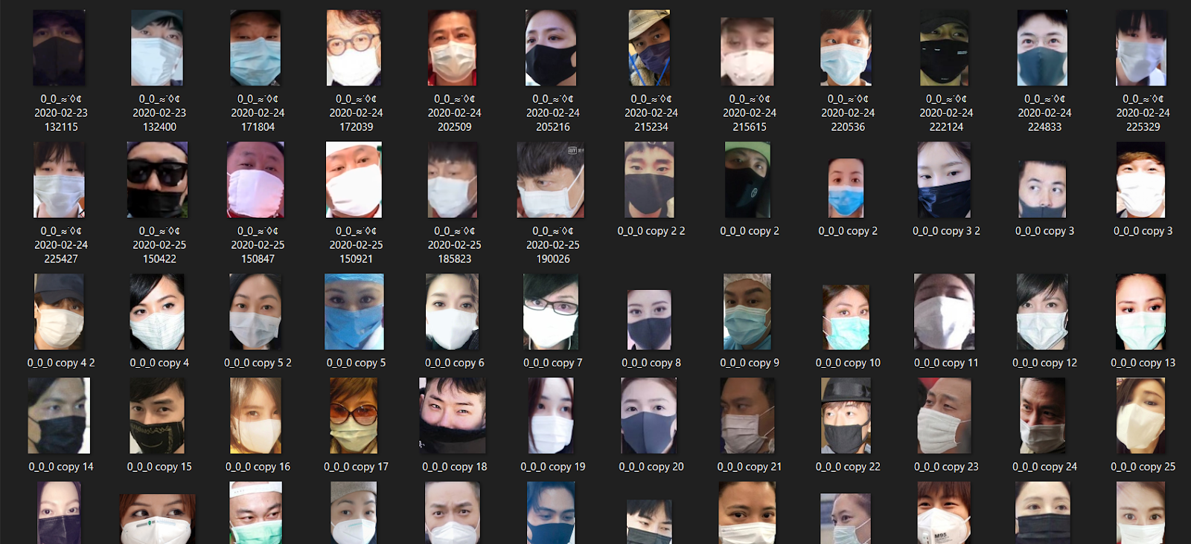
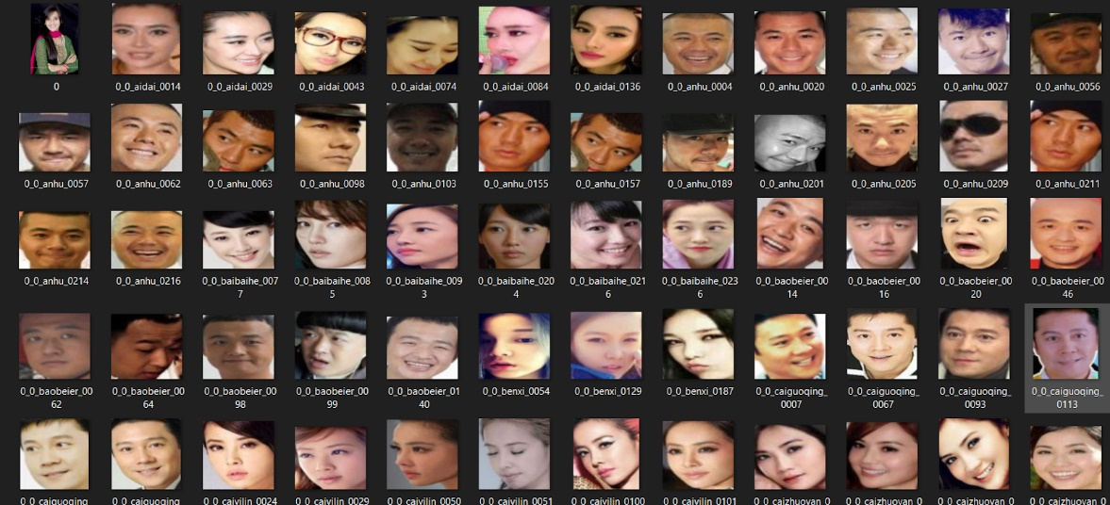
Dataset
<- Dataset With Mask
Dataset Without Mask ->

Slide 18
Methodology
To implement the proposed system, the dataset must first be categorized into 2 parts “with mask” and “without mask” images.
Mobilenetv2 will be used to classify the image so that only the face of the person can be extracted and converted into 2D array and used to train the model.
A CNN model is trained to detect the face mask detection which can be used to detect the mask in image and video format input.
The trained model will find the percentage of mask and non-mask component of the area that should be covered by mask, if the mask part is greater than the non-mask then the person is wearing the mask properly otherwise the other way around.

Slide 19
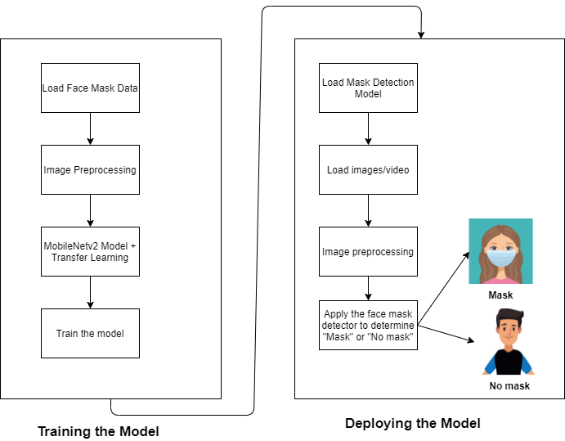
Workflow

Slide 20
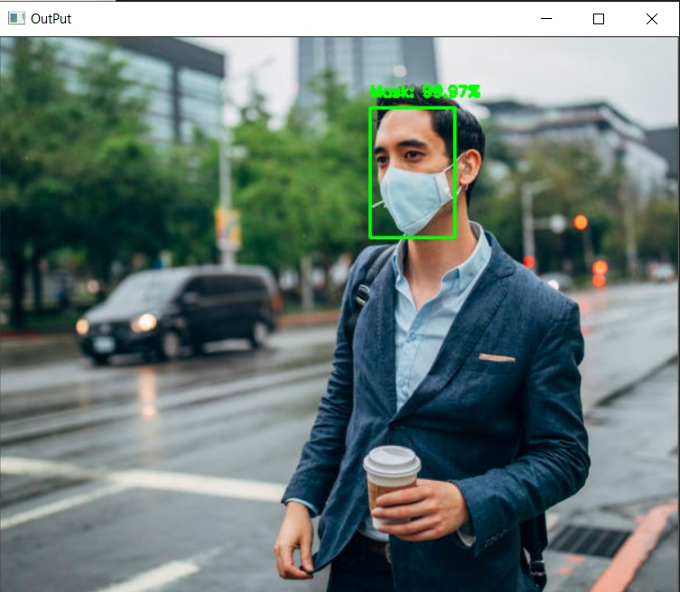
DETECTING FACE WITH MASK

Slide 21
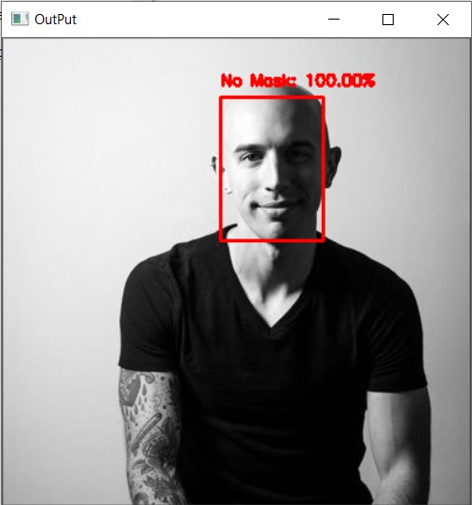
DETECTING FACE WITHOUT MASK

Slide 22
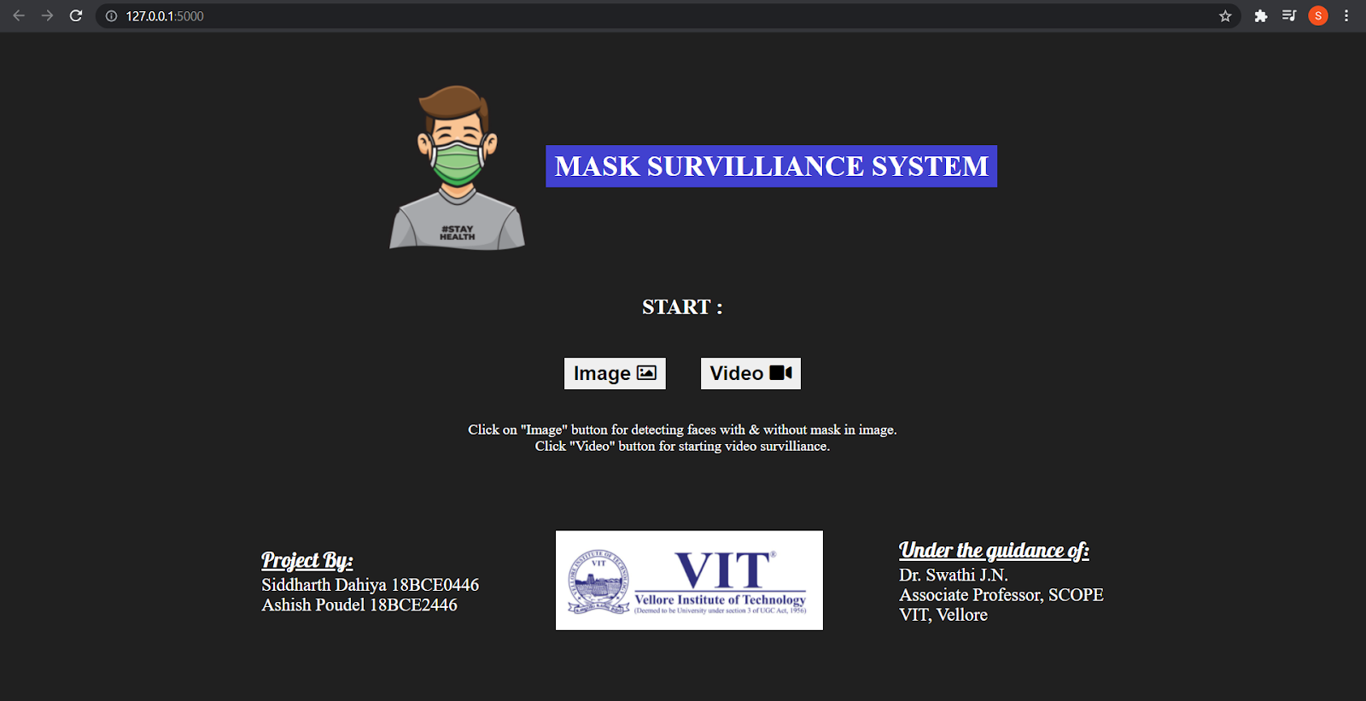
Integration with Front End

Slide 23
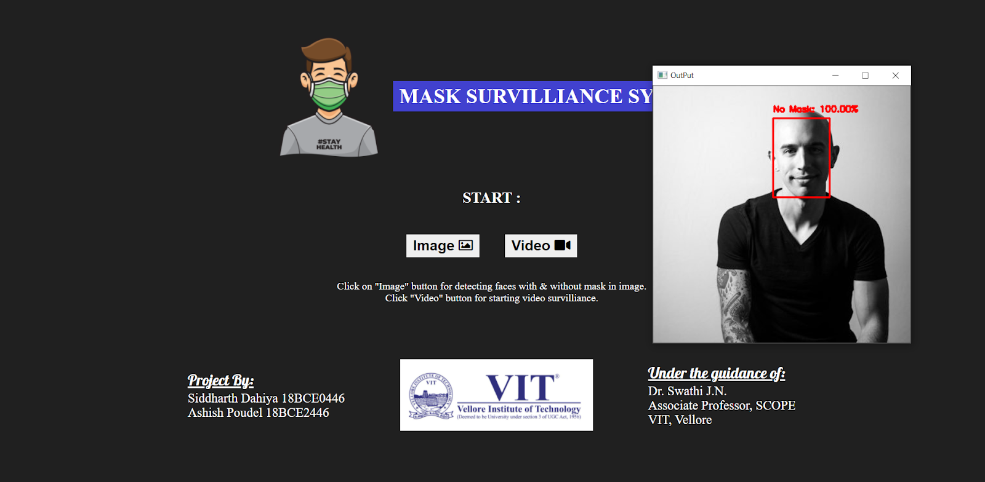
Final Project (For Images)

Slide 24
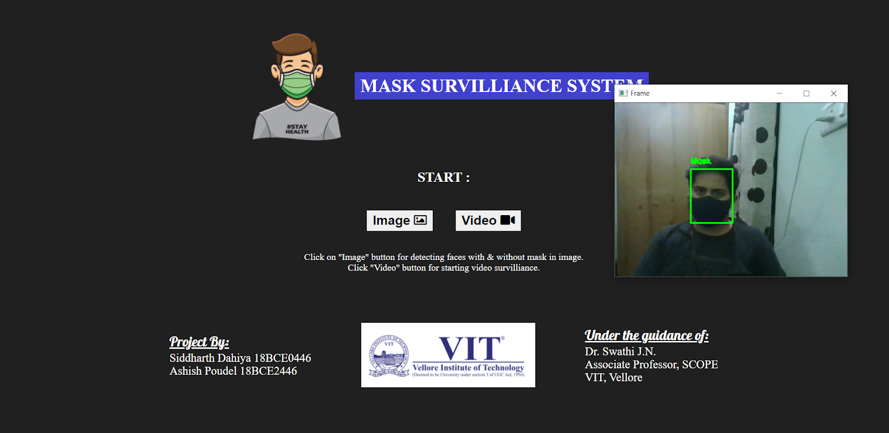
Final Project (For Video)

Slide 25
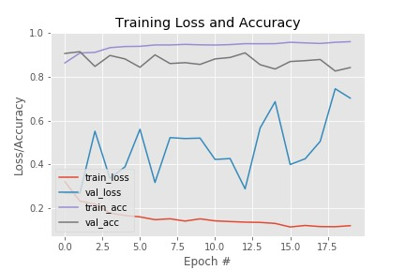
TRAINING LOSS AND ACCURACY

Slide 26
Conclusion
We successfully created a Mask Detection System using the concepts of CNN, Transfer Learning, etc.
The model has a good accuracy of 95.14%
The model was successfully integrated with the Front End webpage(created using HTML+CSS) using Flask.
The project works for both mask detection on images and for video surveillance.
Video Link:
https://drive.google.com/drive/folders/1ISIezEW_bMS4ck9mHDaHcmkaSHBr7Zx-?usp=sharing

